Slide 1
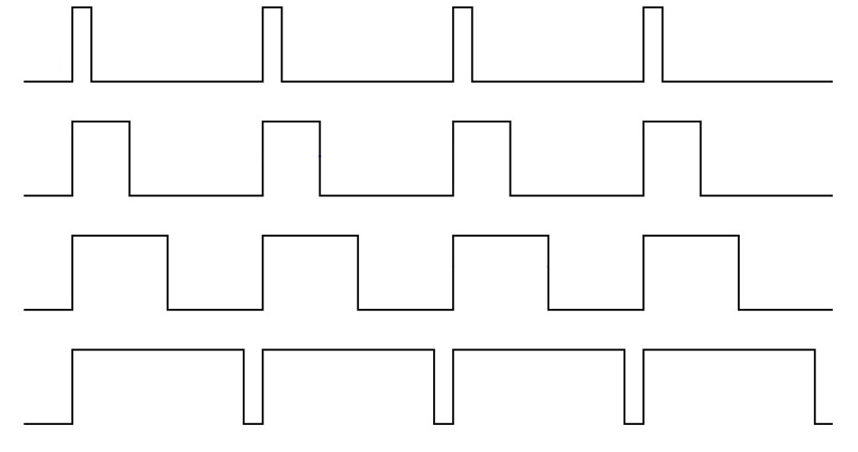
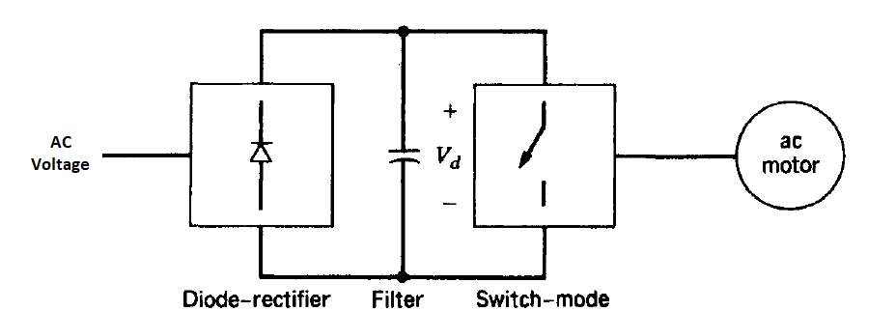
PWM Techniques & AC Drives

Slide 2
Outline
Definition of PWM
PWM Techniques
-Sinusoidal PWM
-Space Vector PWM
3 Level Diode Clamped Multilevel Inverter

Slide 3
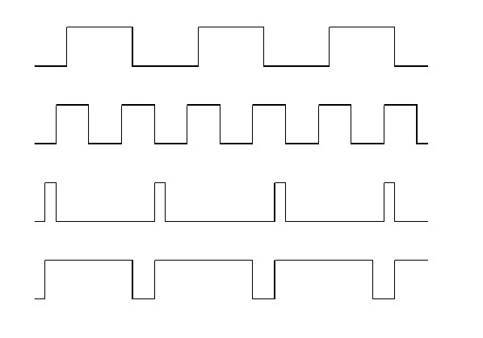
What is PWM?

Slide 4
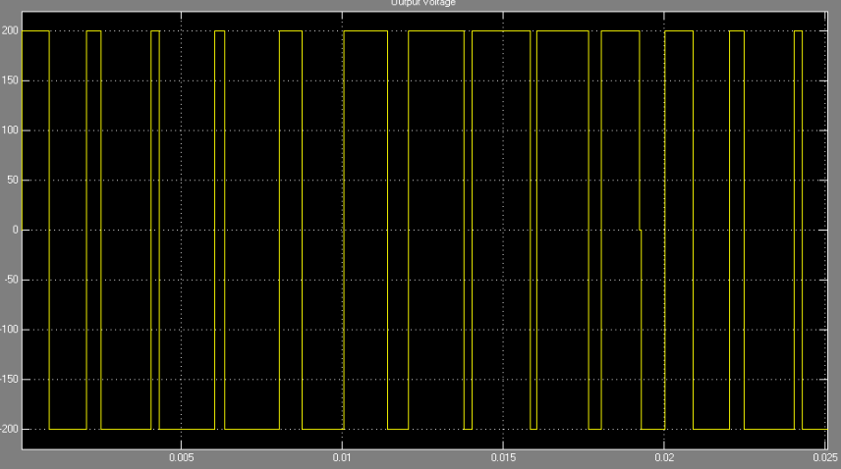
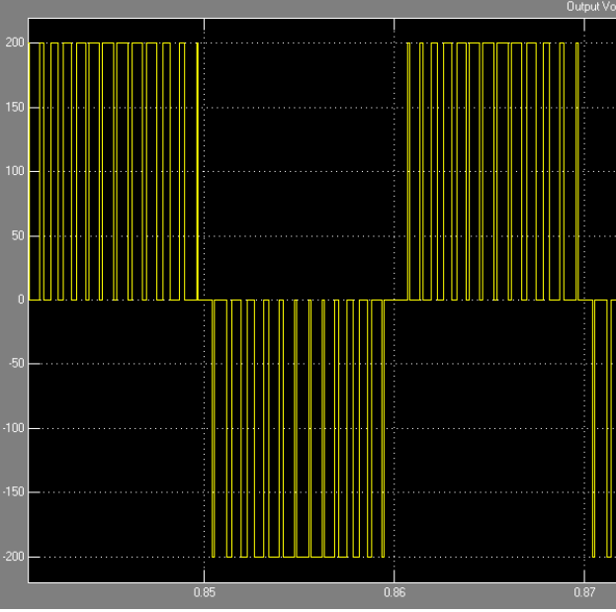
Different PWM Generation Techniques
Sinusoidal PWM
Space Vector PWM

Slide 5
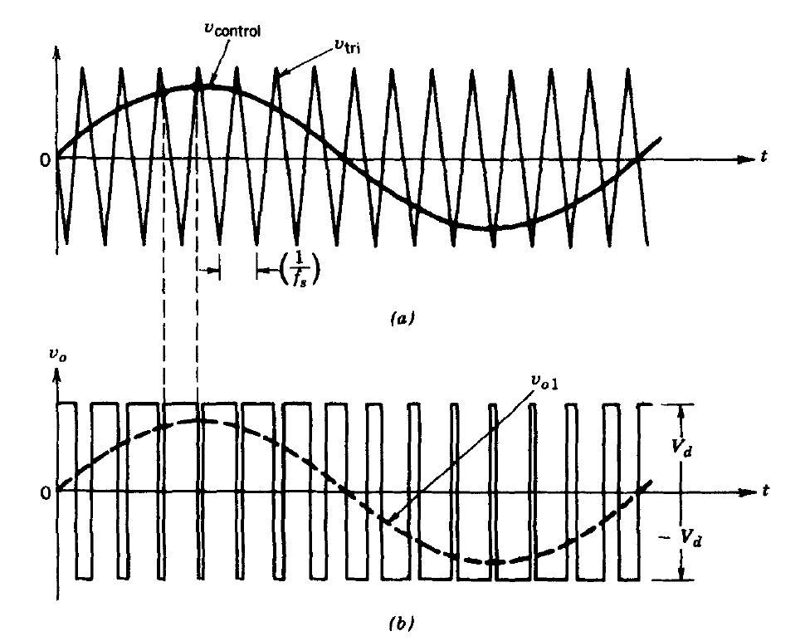
Sinusoidal PWM (Carrier Based PWM)

Slide 6
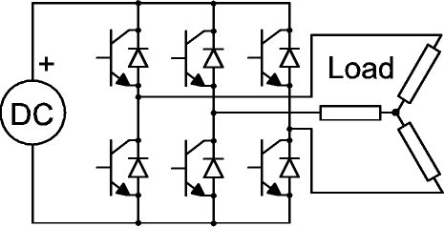
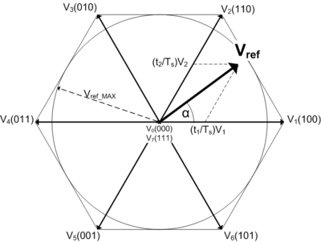
Space Vector PWM

Slide 7
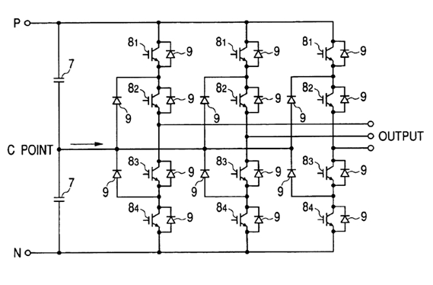
3 Level Diode Clamped Multilevel Inverter
DC link Balancing
Harmonic content
THD of voltage and current

Slide 8
References
Power Electronics: Converters, Applications, and Design – Ned Mohan
High-Power Converters and AC Drive – Bin Wu
Wikipedia

Slide 9


